Slide 1
Shopping Cart App
Angularfire + Firebase – Authentication - Firestore

Slide 2
Login
Register
Login Register
Login Register
Email
Email
Password
Password
Submit
Submit
Facebook
Google
Facebook
Google

Slide 3
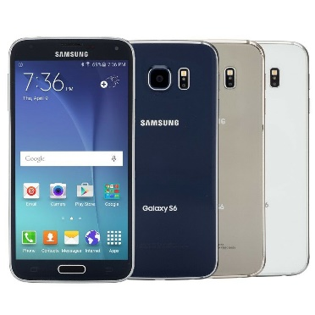
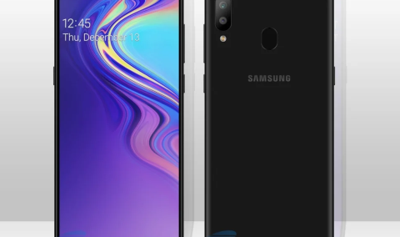
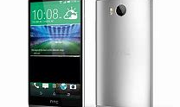
Truxton Mobile
Sony x7i
R9 099.99
Samsung A20
R12 099.99
Motorola V360
R1 099.99
Description:
Description:
Description:
Notes:
Unvarified

Slide 4

Truxton Mobile
Login
Register
Search
Sony x7i
R9 099.99
Samsung A20
R12 099.99
Motorola V360
R1 099.99
Description:
Description:
Description:
AddToCart
AddToCart
AddToCart
Notes:
Unvarified

Slide 5

Truxton Mobile
+4
Logout
username@gmail.com
Search
Sony x7i
R9 099.99
Samsung A20
R12 099.99
Motorola V360
R1 099.99
Description:
Description:
Description:
AddToCart
AddToCart
AddToCart
Notes:
Unvarified

